Slide 1
E-Auction Website
Group 7
Group Members :
Nivedita Singh -- 1201016975
Shubham Srivastava -- 1201023762
Smriti Komal -- 1201025580

Slide 2
OBJECTIVE
The objective is to create an Online Auction Website. It provides a platform where the seller and buyer come together to sell or bid for antique watches through the internet and exchange their item.
There are two types of Users- CUSTOMER and VENDOR.
VENDOR : They can edit their profile, upload item for auction, set the base amount for bid of item, set start and end date of auction and can view the bid status.
CUSTOMER : They can edit their profile, view the details of items up for auction and can bid to buy an item.
It provides a login module. Login module includes various utilities like user registration, authentication and reset password. After successful login, the user would be taken to his respective module. After end of auction time, item is delivered to the buyer with max bidding price, required payment is made by the buyer to the vendor .

Slide 3
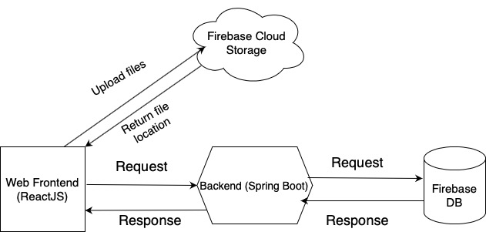
DATA FLOW DIAGRAM

Slide 4
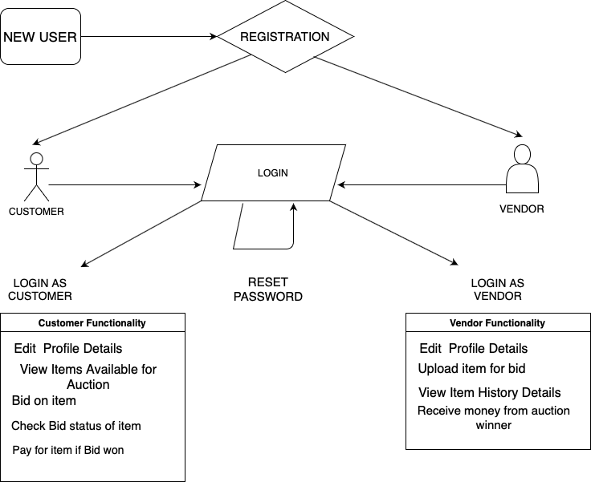

Slide 5
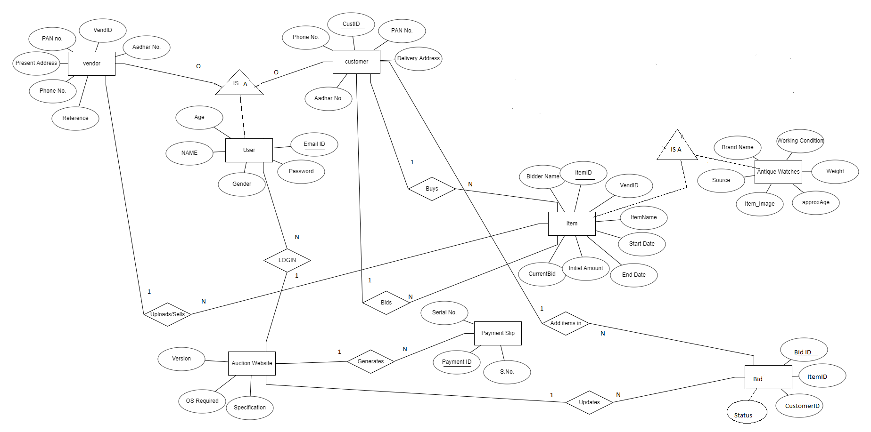
ER Diagram

Slide 6
SOFTWARE REQUIREMENT
FRONTEND - REACT.JS (JavaScript) ( HTML, CSS, Material UI library)
BACKEND - SPRING BOOT (Java) running on Apache Tomcat Webserver, a local JDK installation
DATABASE - FIREBASE (Cloud)

Slide 7
HARDWARE REQUIREMENT
Memory - Minimum 4 GB RAM
Display - 1024 X 768
Processor - Pentium IV onwards

Slide 8
USER MANUAL
Login - Using your Registered Email id and Password.
Registration - For new users, Register with us by filling all the required details to the best of your knowledge.
Password - Must be at least 8 characters comprising of at least one uppercase letter, one special character and one digit.
Forgot Password - Reset your password by validating Aadhar Number and Email-id.
Update Profile - Customer and Vendor can update their mobile number and address.
Add Item - Vendor can upload the item’s details for Auction :
Brand Name , Base Price, Source etc
Item’s photo (not greater than 120 KB)
Start and End Date & Time for auction following certain rules.
Bid Item - Customer can bid for any item that is up for auction (at a price higher than base price).
History - Vendor can view item uploaded for auctions previously and other details after successful auction. Customer can view items bidded by them and result for that item.

Slide 9
API Documentation
CUSTOMER APIs :
1. getItemList /items/watch/getItemList/{auctionType} auctionType : Can either be upcomingAuction or ongoingAuction
2. getItemDetails /items/watch/getItemDetails/{itemID}
3. postBidDetails /items/watch/postBidDetails
4. getBidDetails /items/watch/getBidDetails/{bidID} bidID is a combination of customerID_itemID.
5. getCustomerHistory /getCustomerHistory/{userID} returns a combination of Bid object and ItemWatch object depending on whether the Bid type variable bidResult is either :bidResultPossibility[]={"SUCCESSFUL", "FAILED", "ONGOING"}
VENDOR APIs :
1. postItemDetails /items/watch/postItemDetails
2. getVendorHistory auctionStatusPossibility={"upcoming", "ongoing", "end"}; transactionStatusPossibility={"successful", "failed", "upcoming"};returns a Map of auction status and item details,where itemDetails includes a key transactionStatus - which is successful if someone has bid for the itemfailed if noone has bid for the item and the auctionStatus is end. transactionStatus is upcoming if auction status is either ongoing or upcoming

Slide 10
DEVELOPER MANUAL
Prerequisites: Knowledge of HTML, CSS, Java Script, ES6 features and understanding of using npm for frontend development in ReactJS. Knowledge of Java language and firebase database for backend.
Also Java 1.8, gradle 6.8.3, Spring framework needed.
A brief description of the frontend folders in src:
-- User Login: It has files like Login.js, resetPassword.js, Registration.js etc. Login.js is used to login both customer and vendors. On successful login user is directed to customer/vendor pages accordingly. If user is not registered or forgot their password then they are directed to resetPassword.js/ Registration.js .
-- Customer module:
AppC.js is the home page for customer. It routes the customer to Edit.js, Bid.js and Card.js etc
Edit.js is used to edit profile, Bid.js to bid for items in auction, Card.js to view bidding history.
Vendor module:
AppV.js is the home page for vendor. It routes the customer to Edit.js, Ihistory.js and InputD.js Edit.js is used to edit profile, InputD.js to upload items for auction, Ihistory.js to view item history.

Slide 11
USER
MODULES

Slide 12
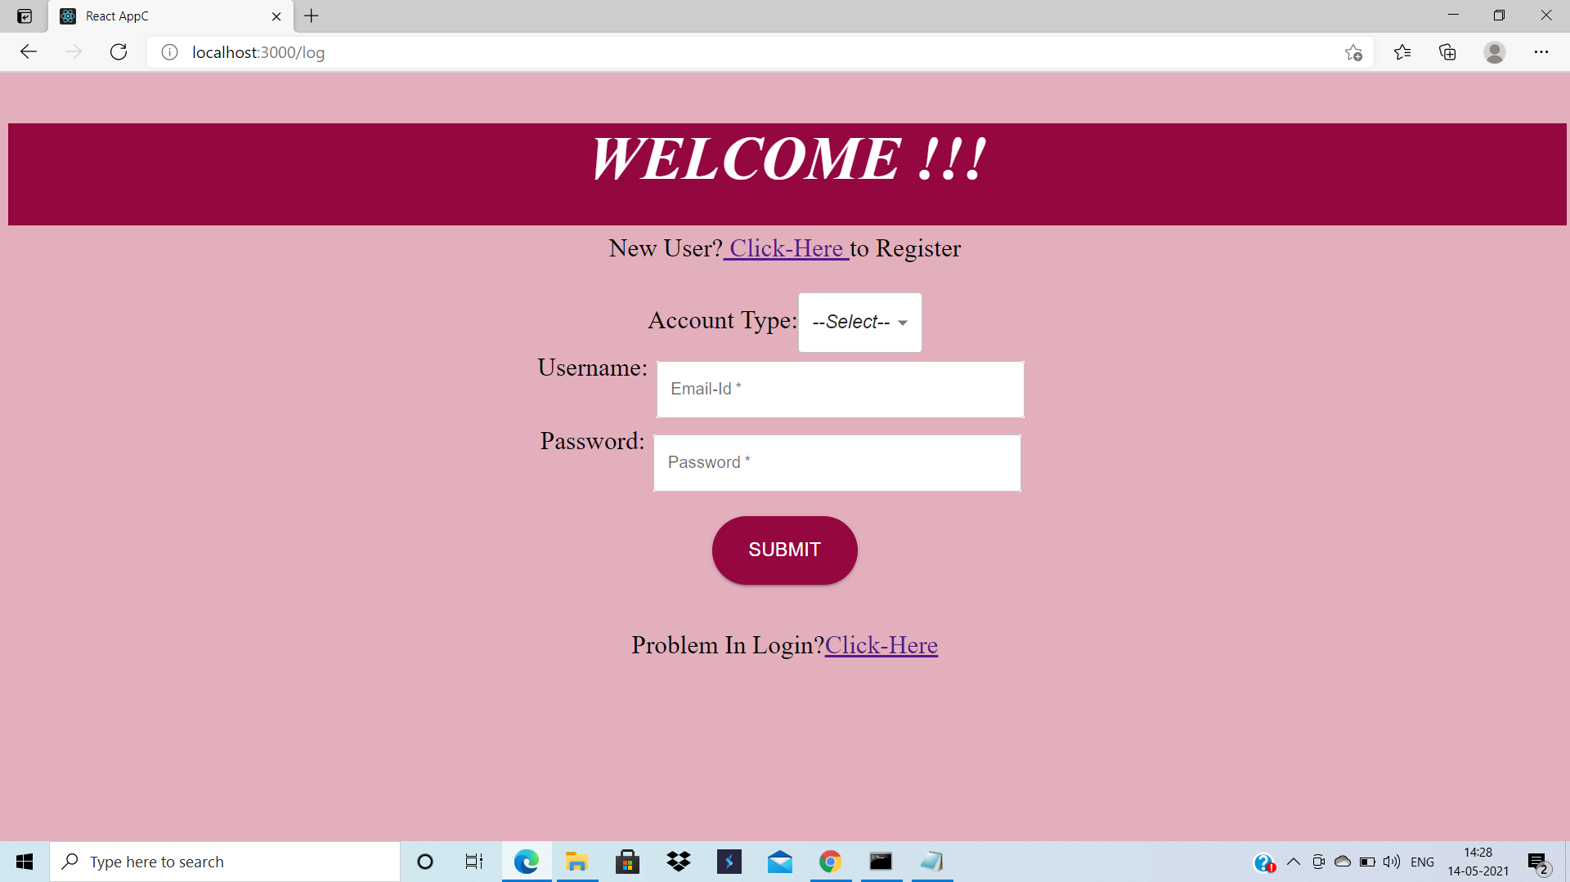

Slide 13
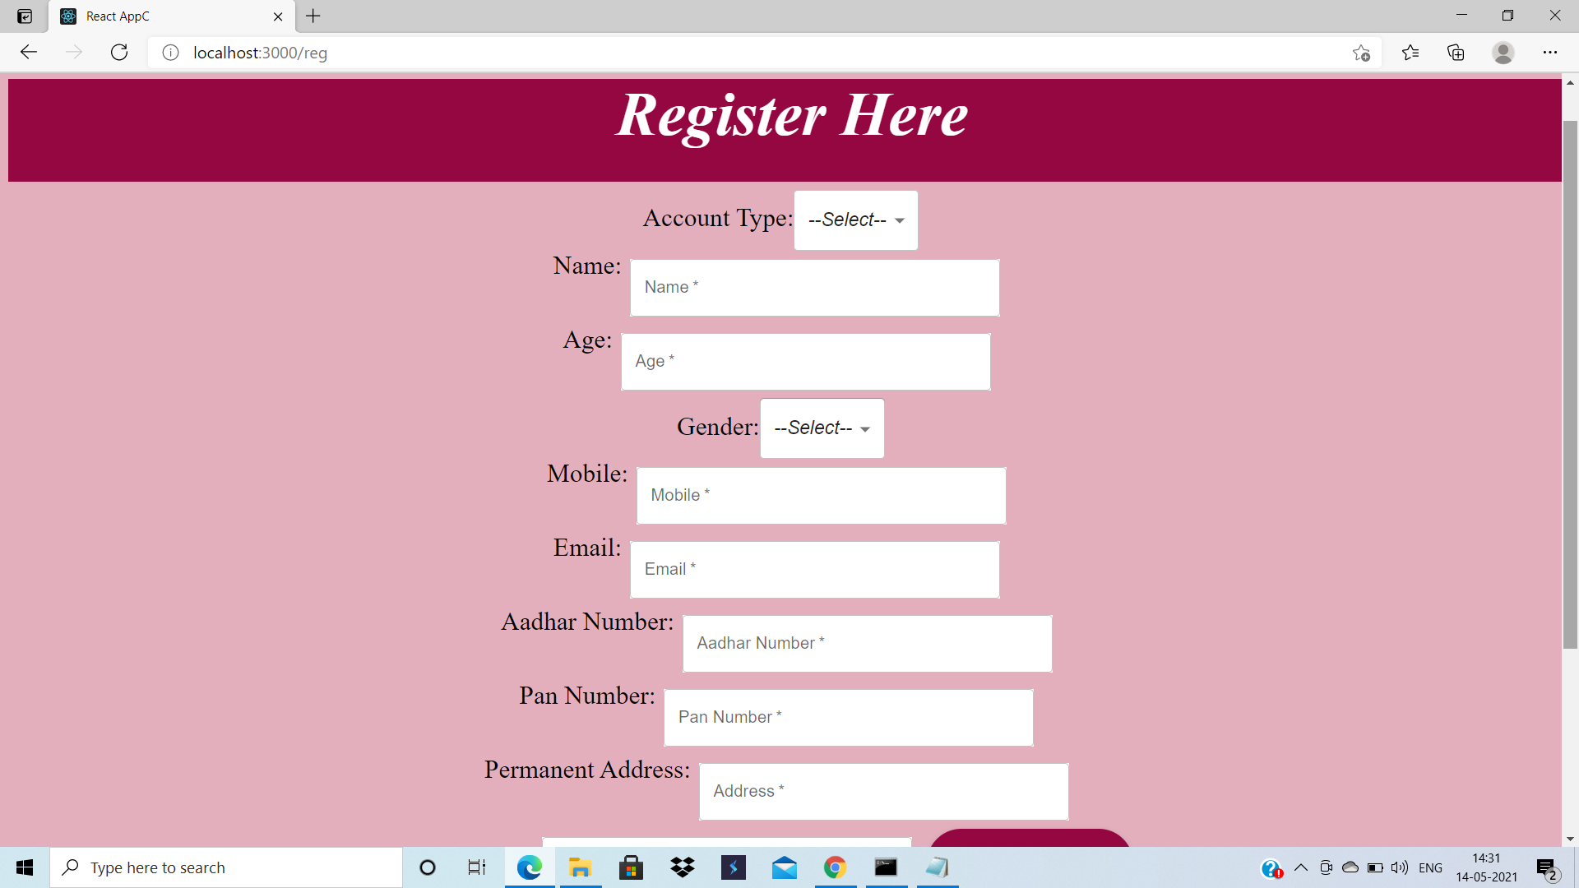

Slide 14
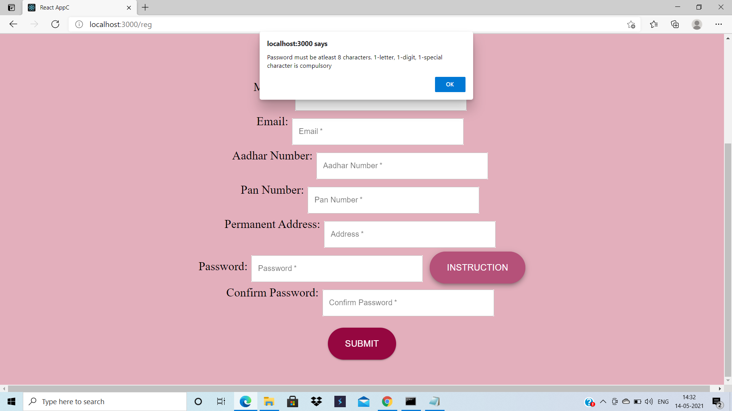

Slide 15
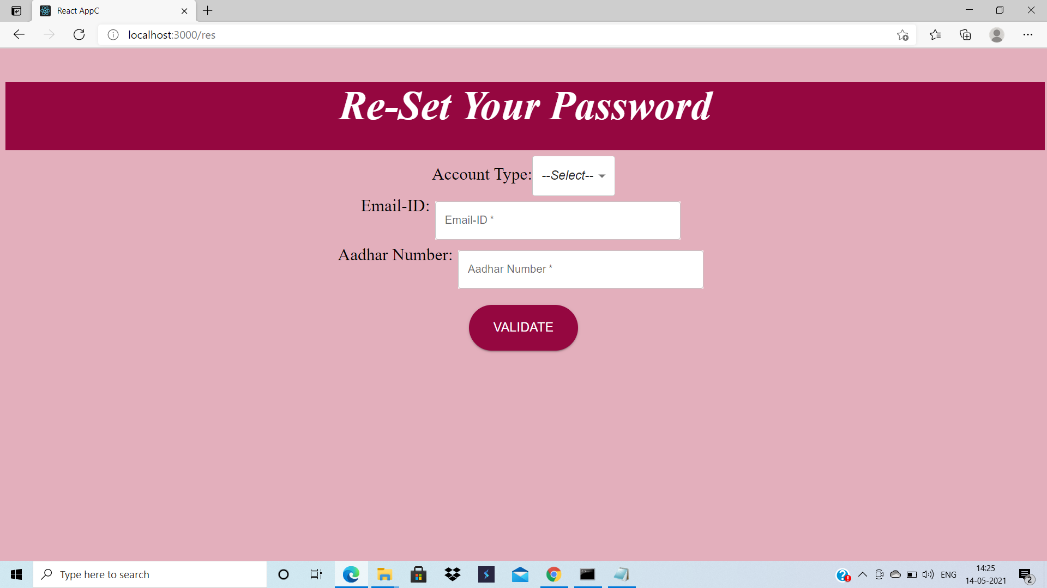

Slide 16
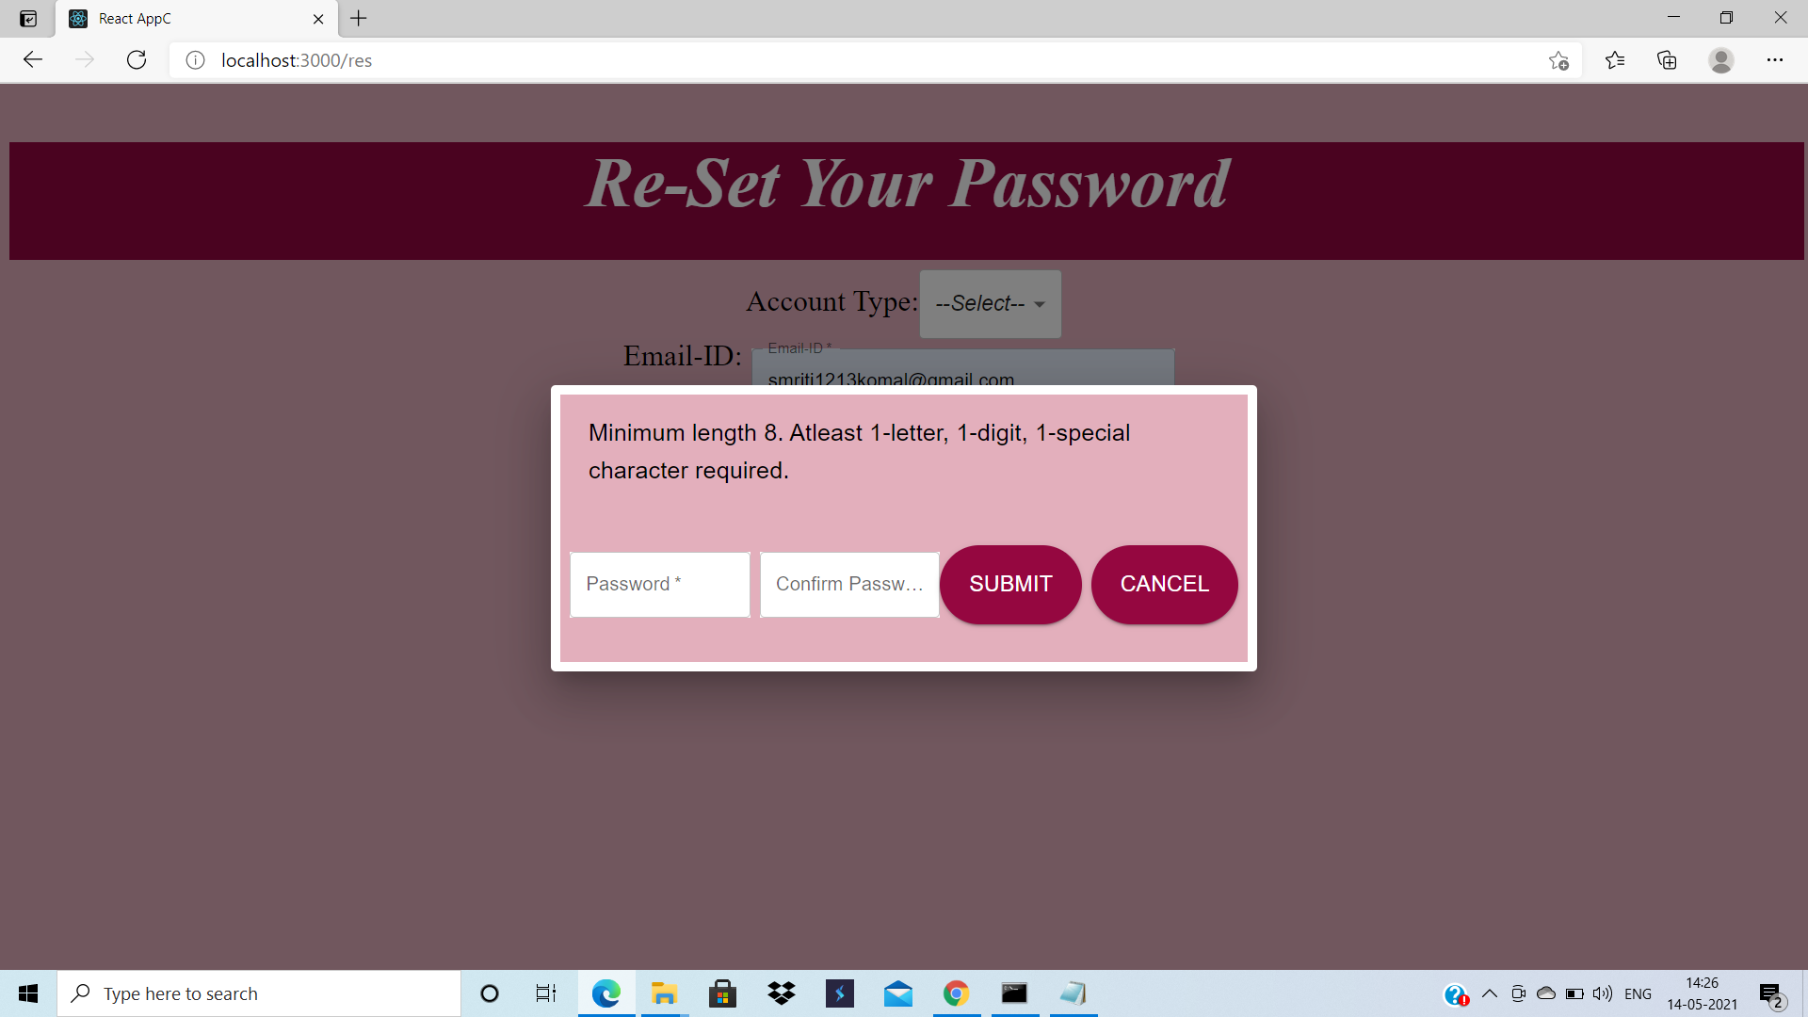

Slide 17
VENDOR
MODULES

Slide 18
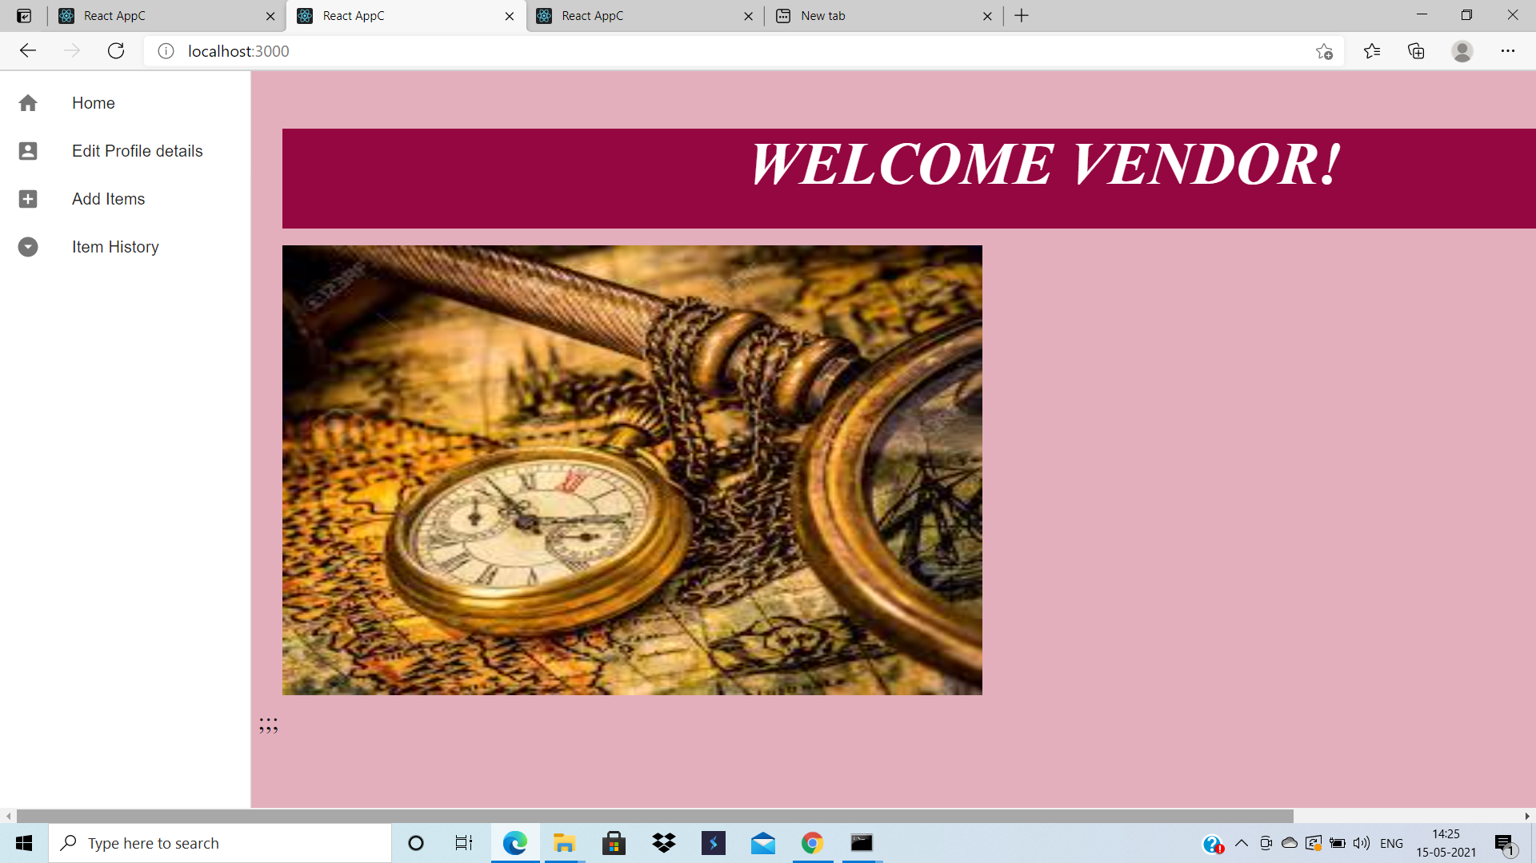

Slide 19
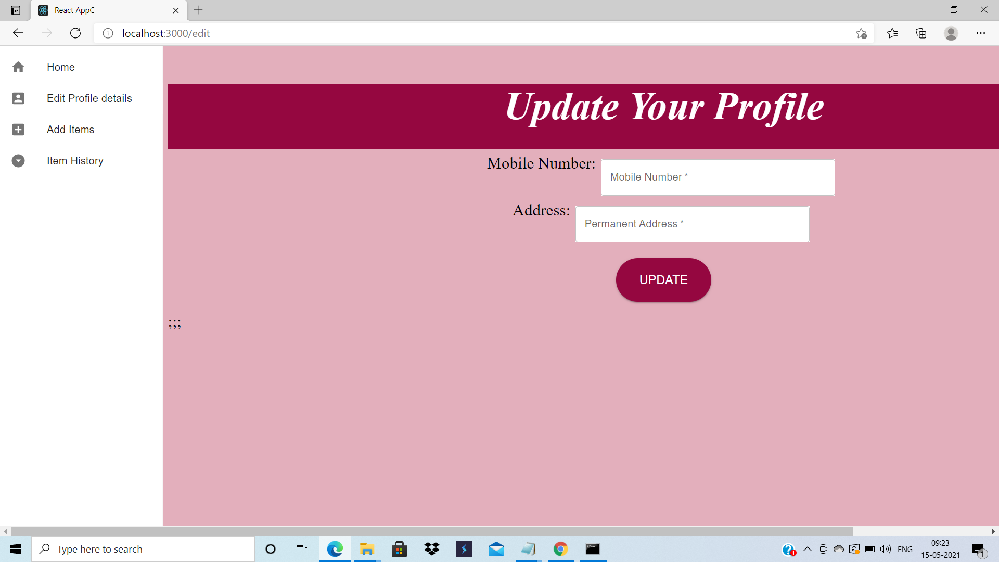

Slide 20
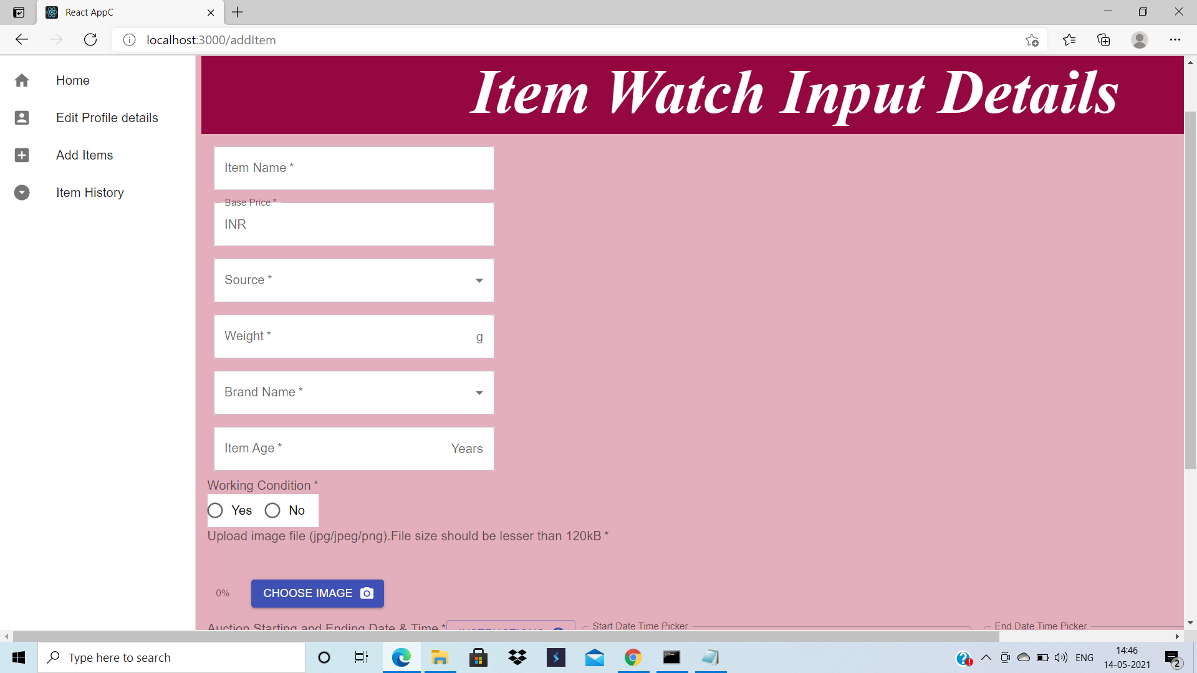

Slide 21
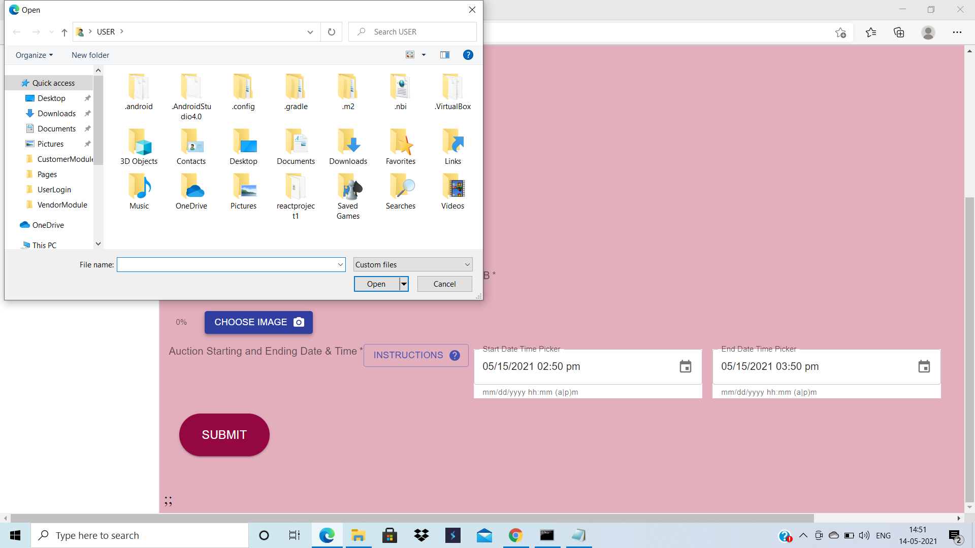

Slide 22
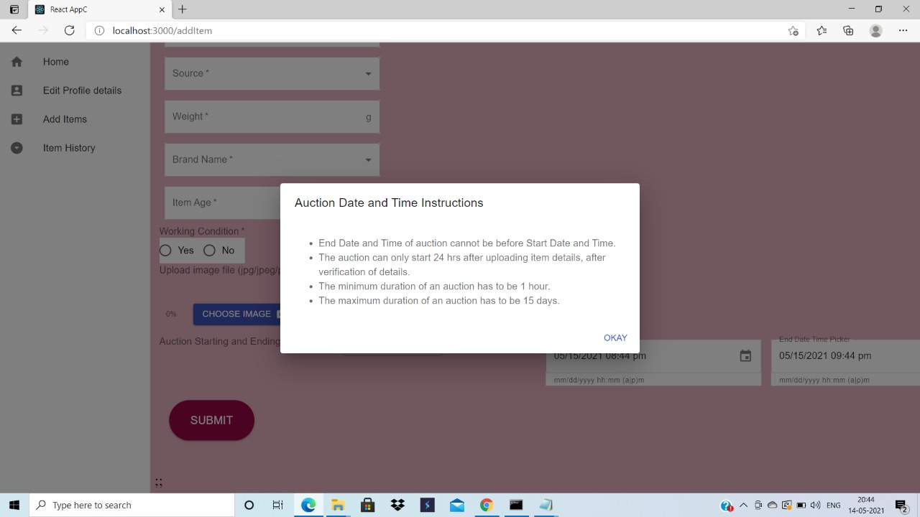

Slide 23
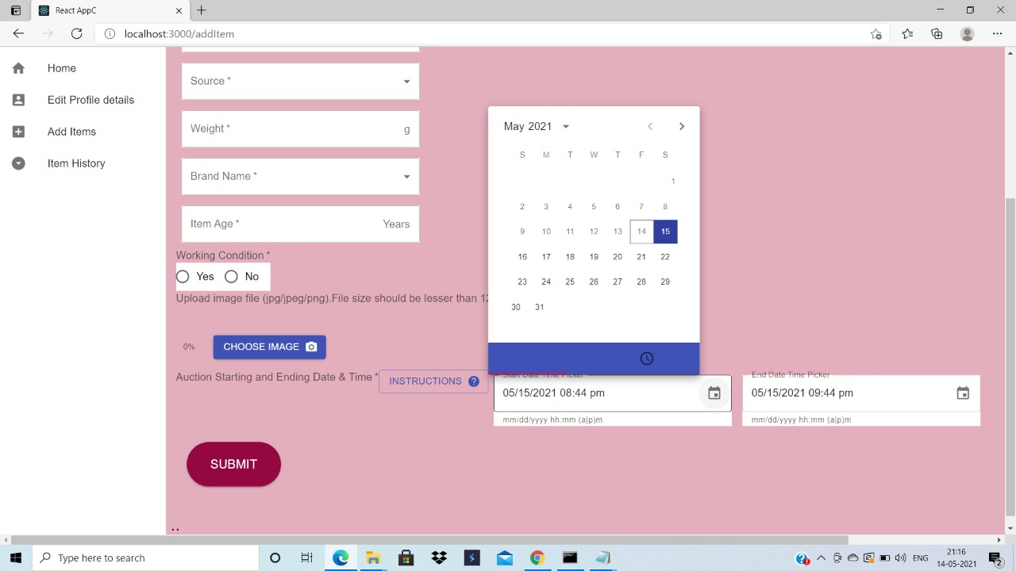

Slide 24
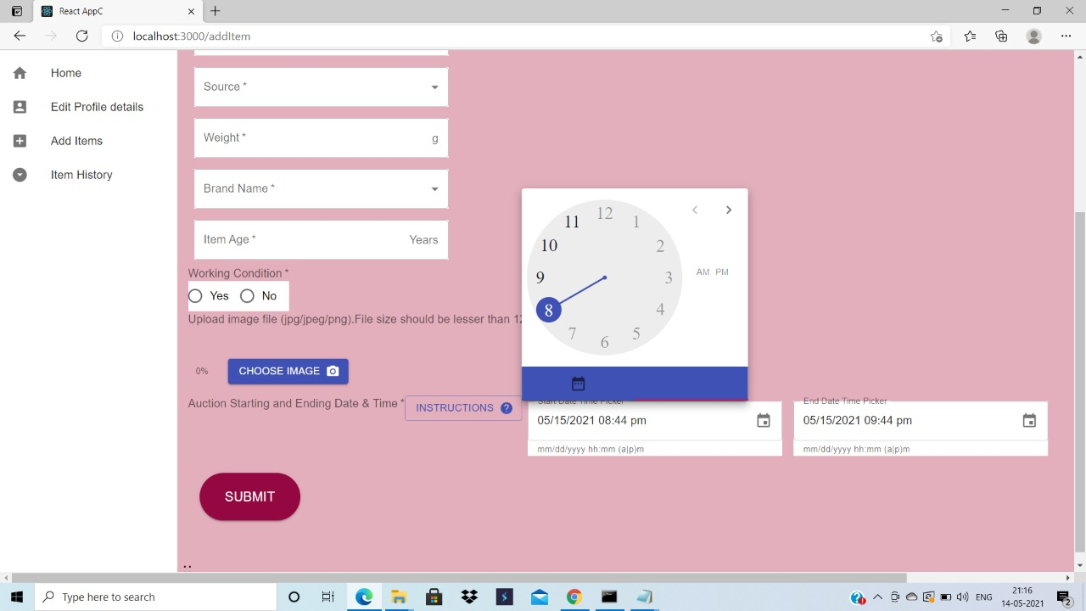

Slide 25
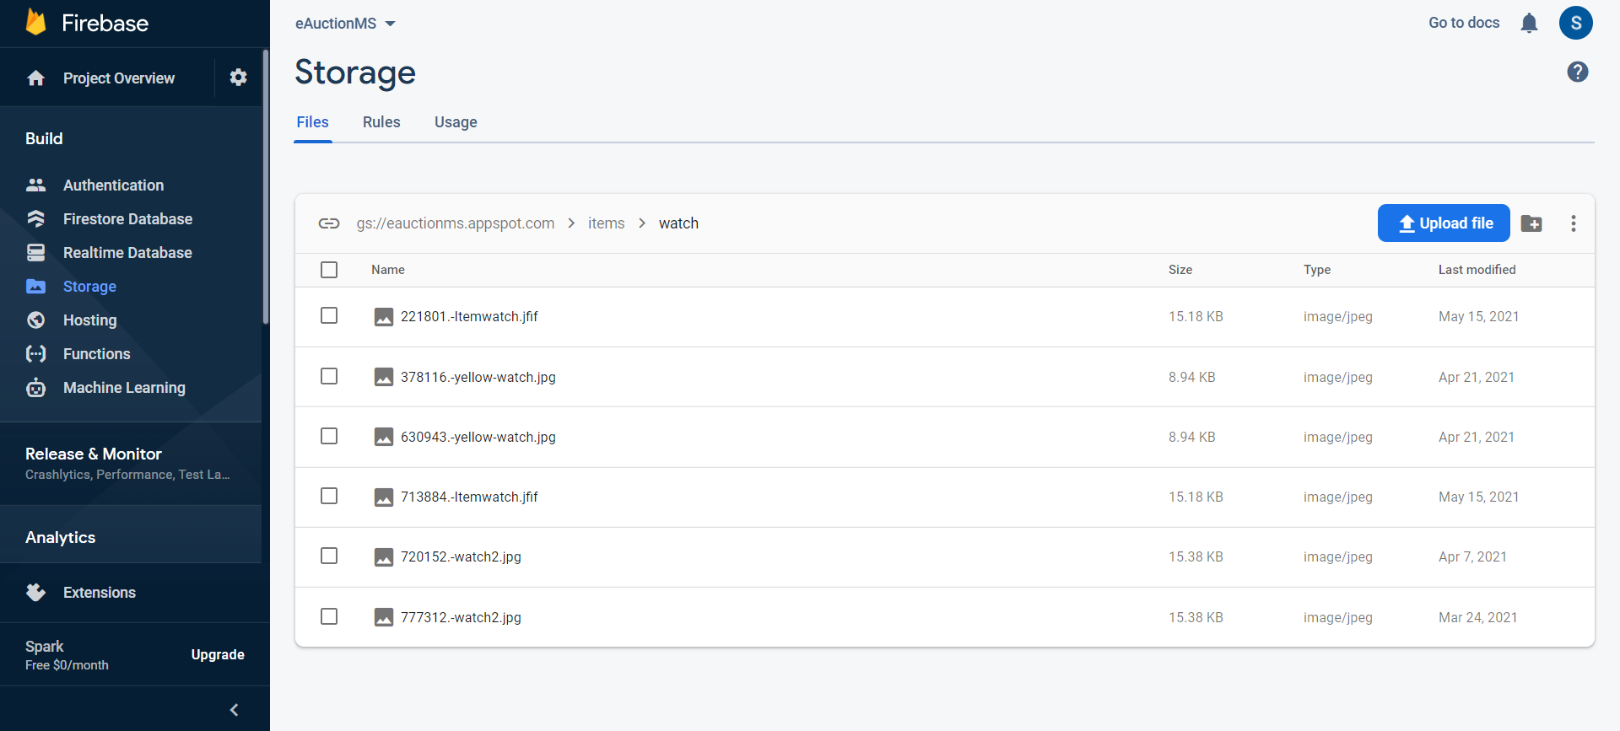

Slide 26
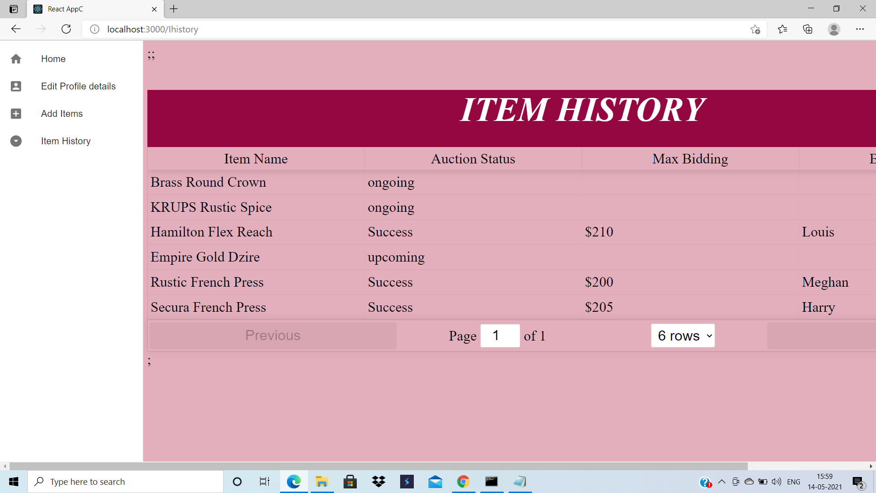

Slide 27
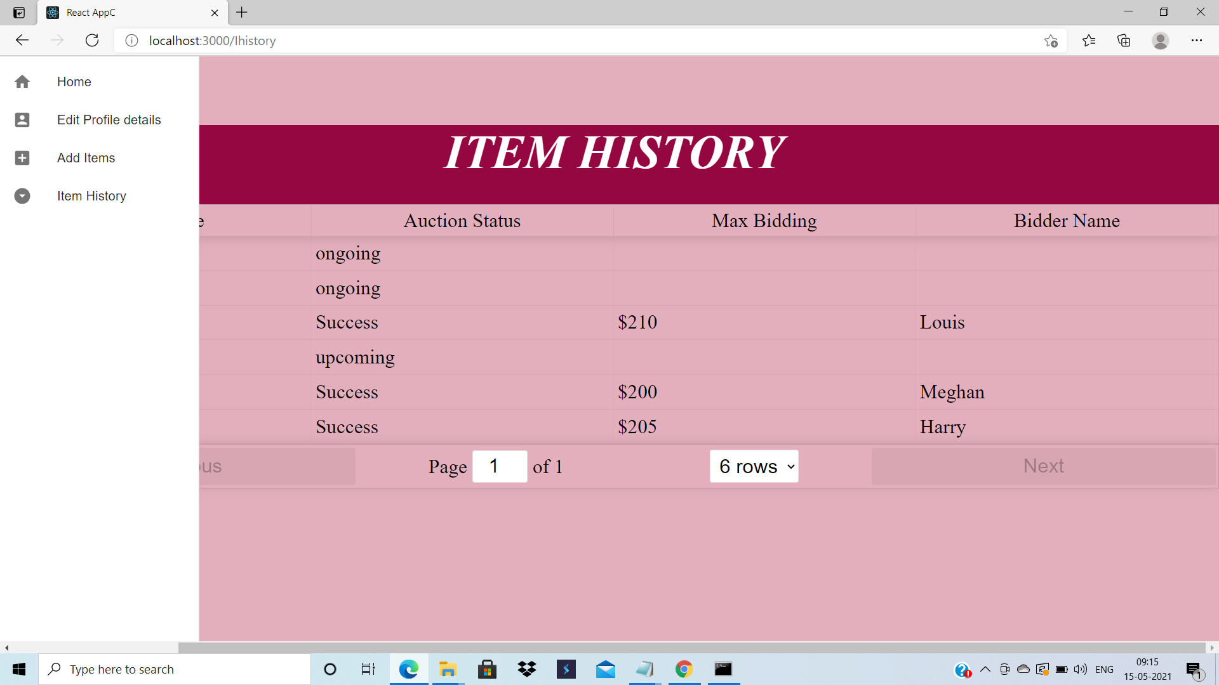

Slide 28
CUSTOMER
MODULES

Slide 29
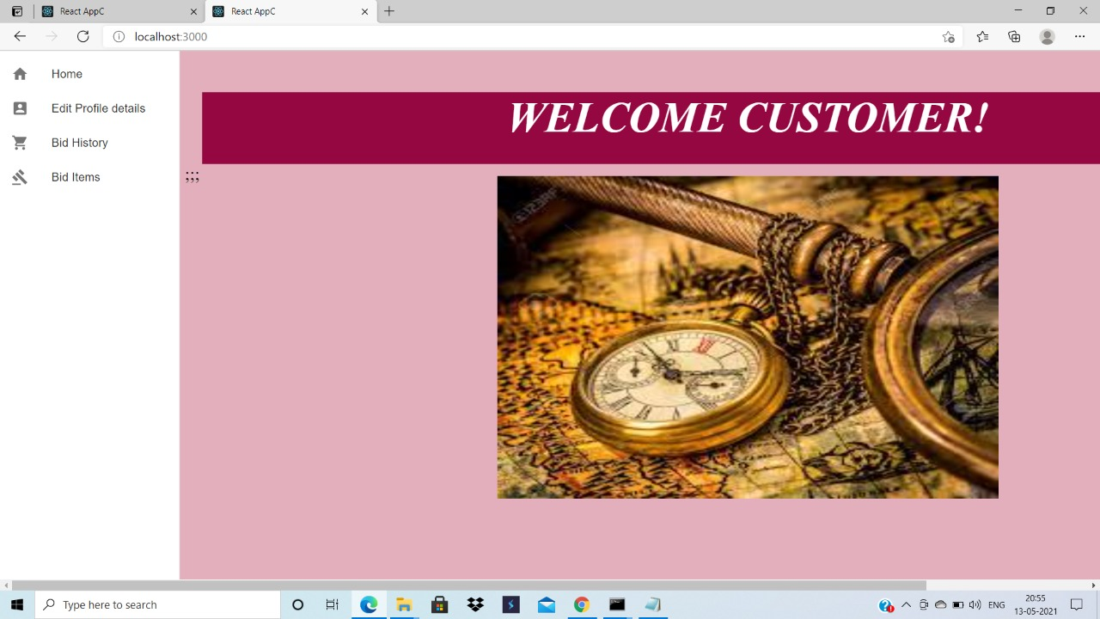

Slide 30
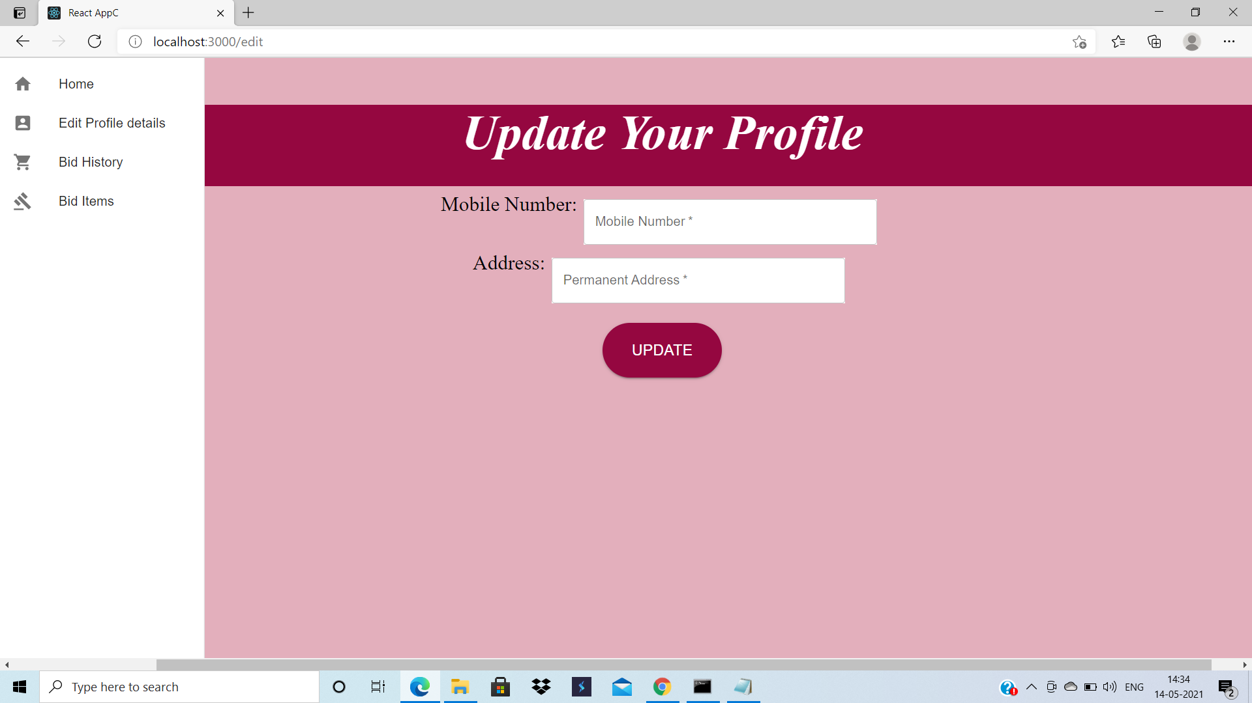

Slide 31
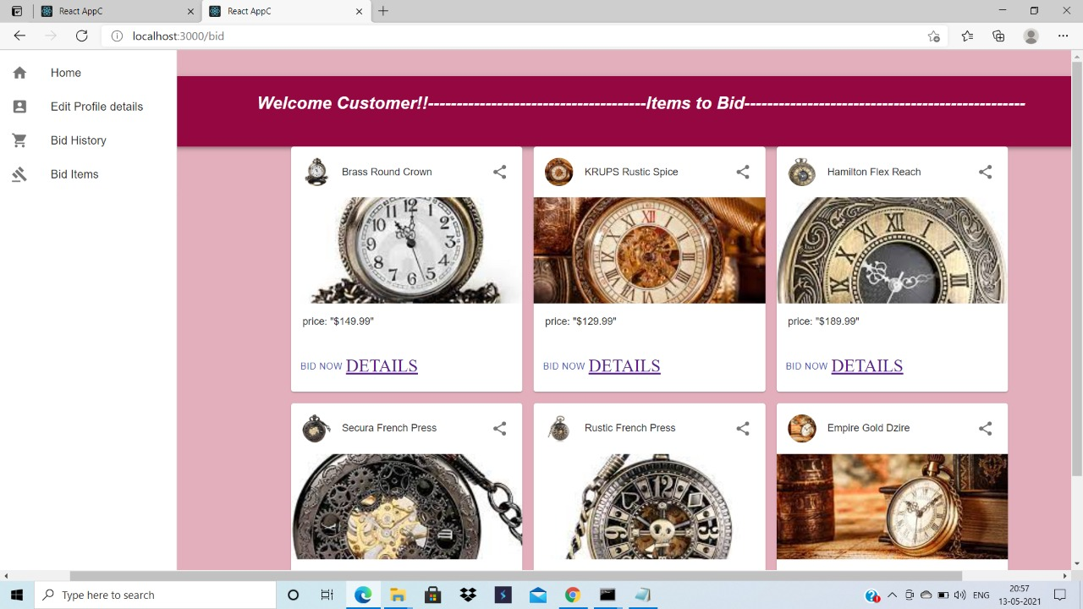

Slide 32
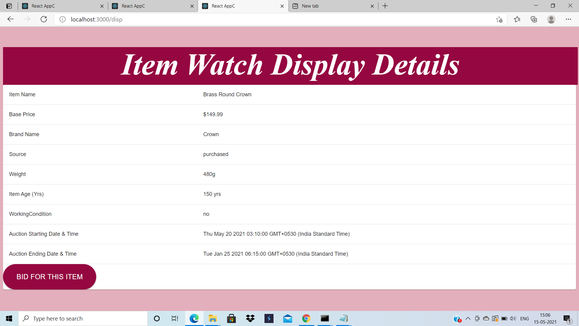

Slide 33
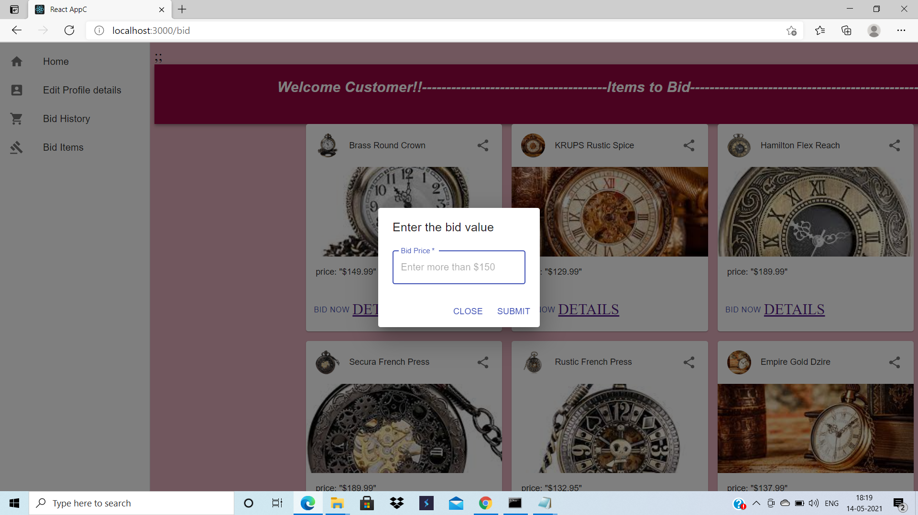

Slide 34
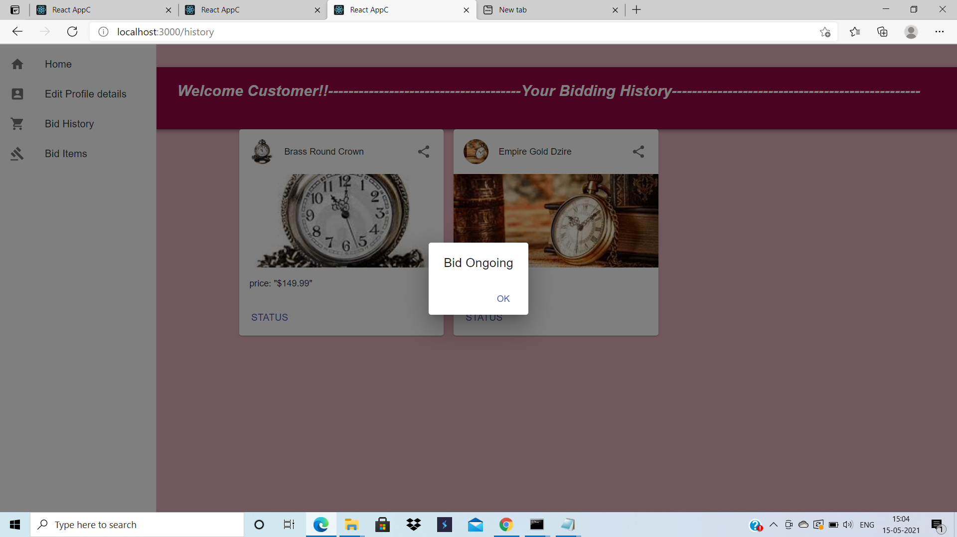

Slide 35
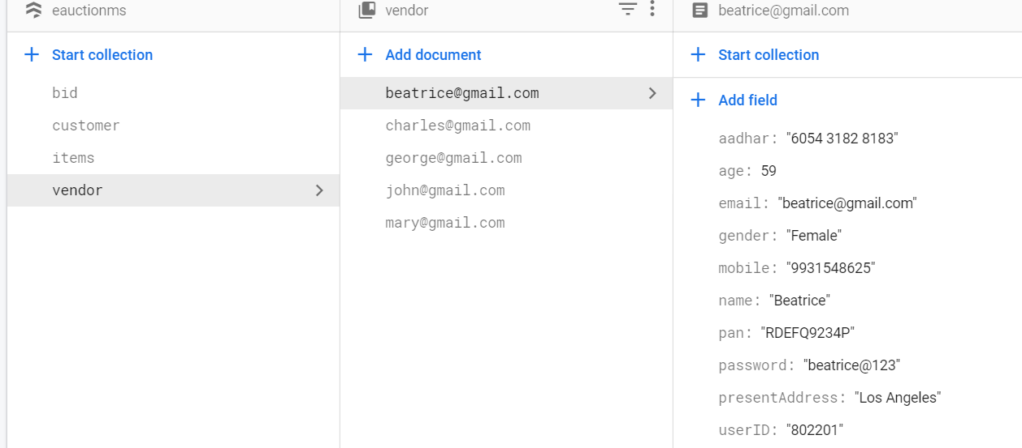

Slide 36
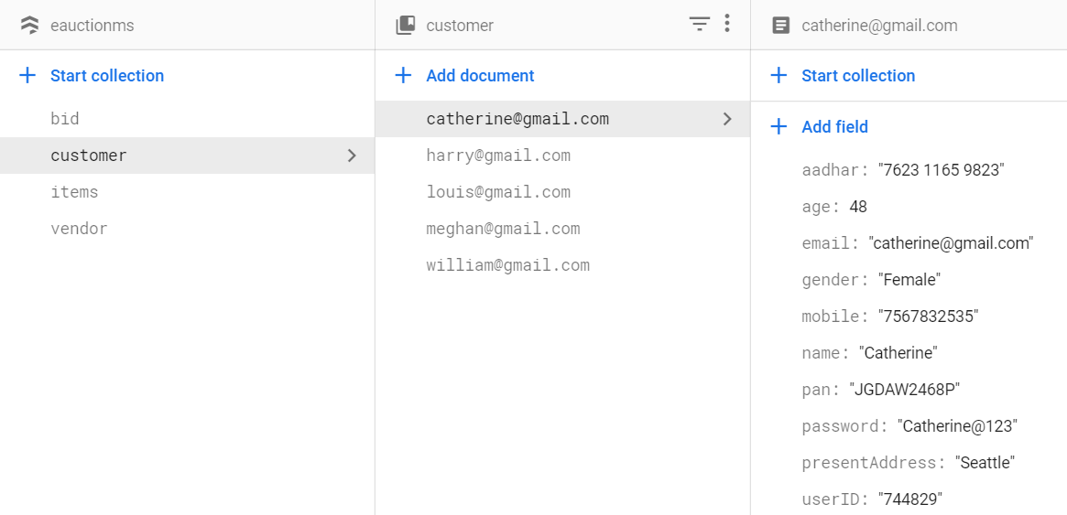

Slide 37
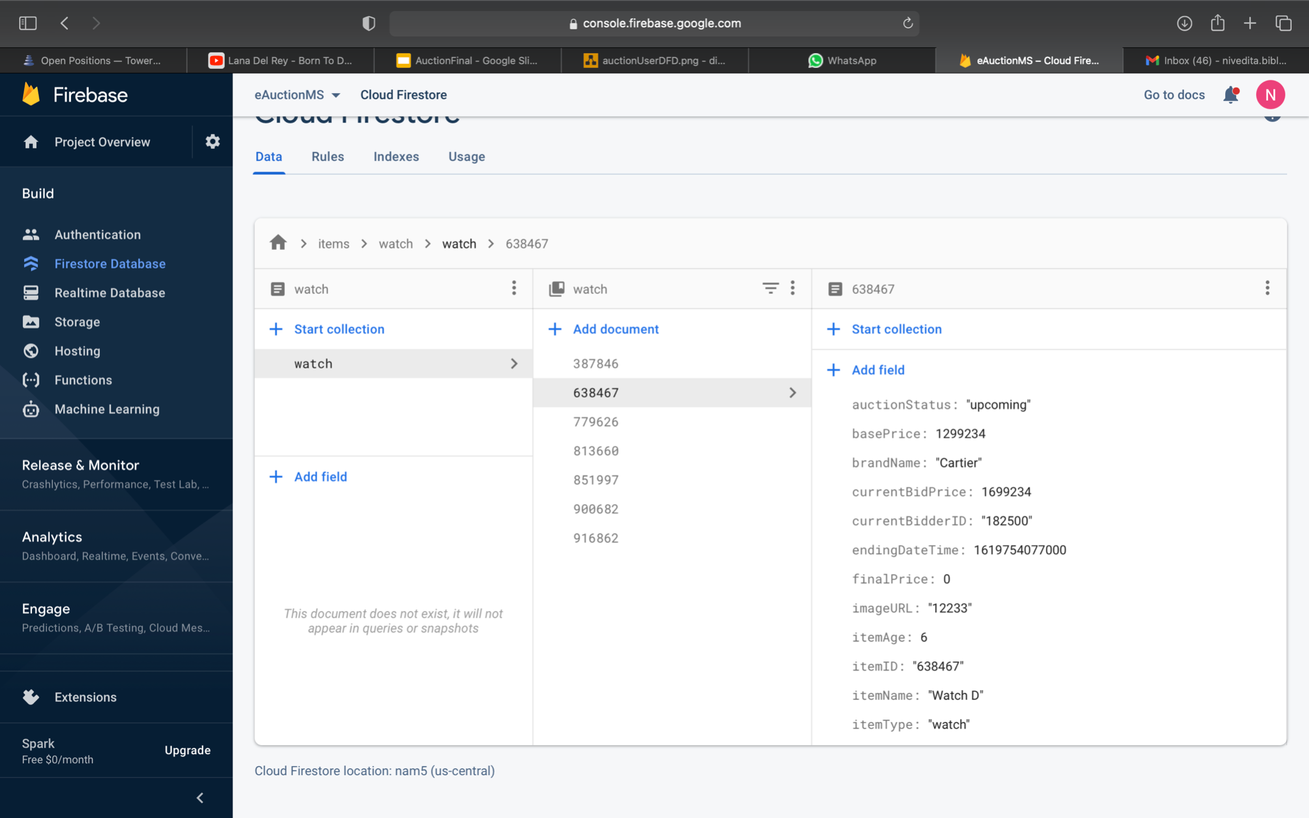

Slide 38
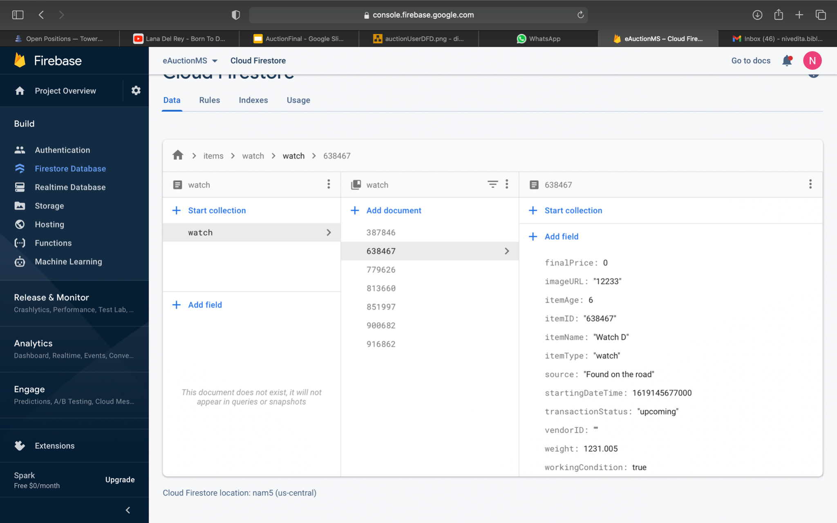

Slide 39
